Slide 1
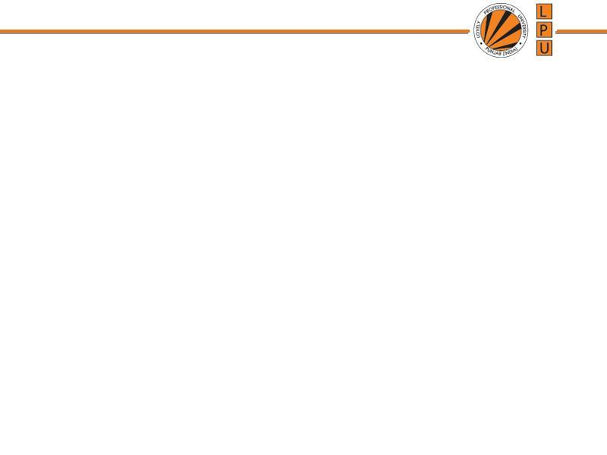
Chapter: Memory Management

Slide 2
Paging / Paged Memory Management
  Paging is a memory management scheme that allows
  processe’s physical memory to be discontinuous, and
  eliminates problems with fragmentation by allocating
  memory in equal sized blocks known as pages.

Slide 3
Paging / Paged Memory Management
  Every process is divided in to number of pages
  Memory is divided into partitions whose size is same as page size : frames
  Each frame has frame no.
  Page size is same as frame size
  Put any page in any free frame
  Paging allows non-contiguous memory allocation
  Page numbers, frame numbers and frame sizes are determined by the machine architecture
  Paging leads to Internal Fragmentation
  Pages size and Frame size is always in powers of two

Slide 4
Paging / Paged Memory Management
  CPU generates logical address and put the pages into random frames
  Mapping is required to map which page is stored in which page number
  From frame no. physical address could be found

Slide 5
Paging / Paged Memory Management
  Physical address space of a process in non- contiguous
  Implementation:
    Frames: Fixed sized blocks of the physical memory
    Pages: Fixed sized slots of the logical memory
  When a process is to be executed, its pages are loaded into any available memory frames.
  Page Table: is a data structure. Used to translate logical address to physical address
  CPU generated logical addresses to fetch the instructions.

Slide 6
Address Translation
  Address generated by CPU is divided into:
  a) Page Number (p): used as an index into page table, which contains base address of each page in the physical memory.
  b) Page Offset (d): combined with base address to define physical memory address that is sent to the memory unit.
  Actual address of any byte in page or frame (Position of instruction in page or frame)
    Address of physical memory, where page resides.
    The number of bits in the offset determines the maximum size of each page, and should correspond to the system frame size.

Slide 7
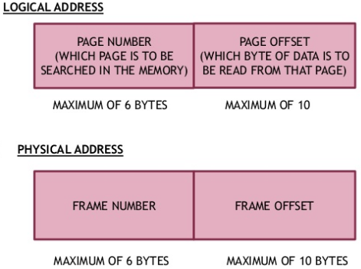
Address Translation

Slide 8
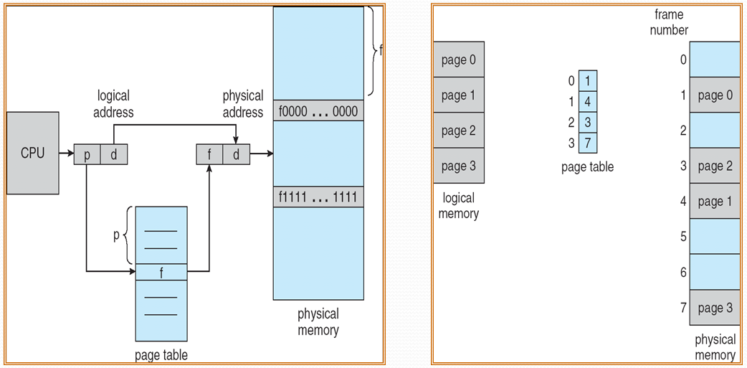
Address Translation

Slide 9
Translation of Address to memory
  How many address combinations can be generated from bits:
  1 bit → 2^1=2 i.e 0 or 1
  2 bit → 2^2=4 i.e 00,01,10,11 ……..so on
  n bits → 2^n combination of address locations can be generated.
  If we have n bit address, and system is byte addressable (every location/partition is of 1 Byte) it will support memory of:
  2^n x 1Byte

Slide 10
Translation of Address to memory
2¹⁰ means 1K i.e 1Kilo (1024)
2²⁰ means 1M i.e 1Mega
2³⁰ means 1G i.e 1Giga
2⁴⁰ means 1T i.e 1Tera
2⁵⁰ means 1P i.e 1Peta

Slide 11
Translation of Address to memory
  Translate n bit address to memory
  Q1. Assume memory is byte addressable and address is of size 14bit. Compute size of memory.
  Ans
  Using 14 bits how many address combinations we can generate? 2^14.
  2^4 x 2^10 =16 K *1 Byte
  = 16KB

Slide 12
No. of bits required to address memory
If memory size is given then compute how many bits are required to address that memory.
Memory Size= Total no. of locations x size of each location
Total no. of locations= Memory Size/ size of each location

Slide 13
No. of bits required to address memory
Q1. Memory size is of 64KB. System is Byte addressable. How many bits are required to represent 64KB?
Ans: 64KB/1B
= 64K
2⁶ x 2¹⁰= 2¹⁶
Total 16 bits are required to rep. memory of 64 KB

Slide 14
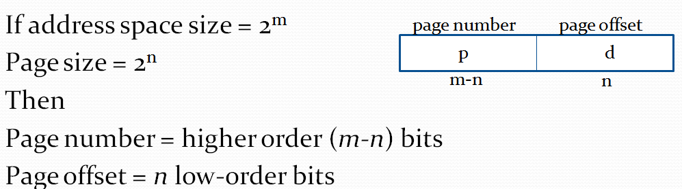
Address Translation
  How to break logical address into page number and page offset?
  Physical Address= frame x page size + offset

Slide 15
Example
  Q. Using a page size of 4 bytes and physical memory of 32 bytes, find the physical address if logical address is:
  4
  10
  Solution:

Slide 16
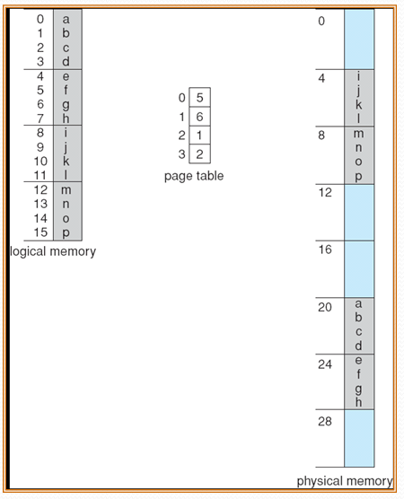
Example- Page Table

Slide 17
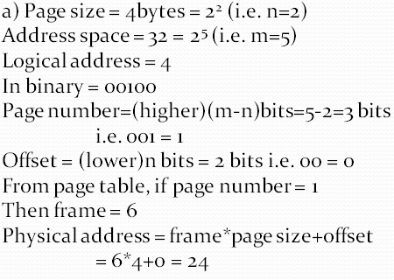
Example
  Q. Using a page size of 4 bytes and physical memory of 32 bytes, find the physical address if logical address is:
  4
  10
  Solution:

Slide 18
Example
  1. if logical address space can hold 2^13 addresses:
  Means
  a) logical address is 13 bit long.
  b) logical address space is 2^13= 8KB if system is Byte addressable

Slide 19
Example
  Q1. LA=24bit
  PA=16bit
  Page Size =1KB. System is byte addressable.
  Find total number of pages and frames.
  Sol:
  We need to compute 4 things in sequence:
  Total addressable locations from L.A and P.A
  Total locations and offset from page size and total bits to represent page size.
  Total pages.
  Total frames.

Slide 20
Example
Sol: Total addressable locations from 24 bits
2²⁴ = 2⁴ x 2²⁰ = 16M
Every location is byte addressable
So Total memory:
16Mx1B= 16MB
Total addressable locations from 16 bits
2²⁴ = 2⁶ x 2¹⁰ = 64K
Every location is byte addressable
So Total memory:
64Kx1B= 64KB
c) Page size= 1KB
total addressable locations and offset = Page size/ size of each location
= 1KB/1B
=1K locations

Slide 21

Example
c) Page size= 1KB
total addressable locations and offset = Page size/ size of each location
= 1KB/1B
=1K locations
Total bits required to represent 1K locations:
2¹⁰ i.e. 10 bits
So offset is 10bit.
d) Total pages with 14bit
2¹⁴ = 2⁴ x 2¹⁰ = 16K pages
e) Total frames with 6bit
2⁶ = 64 frame

Slide 23
Example
  Q2. LA=33bit
  PA=24bit
  Page Size =2KB. System is byte addressable.
  Find total number of pages and frames.
  Sol:
  Total pages = 4M
  Total frames= 8K

Slide 24
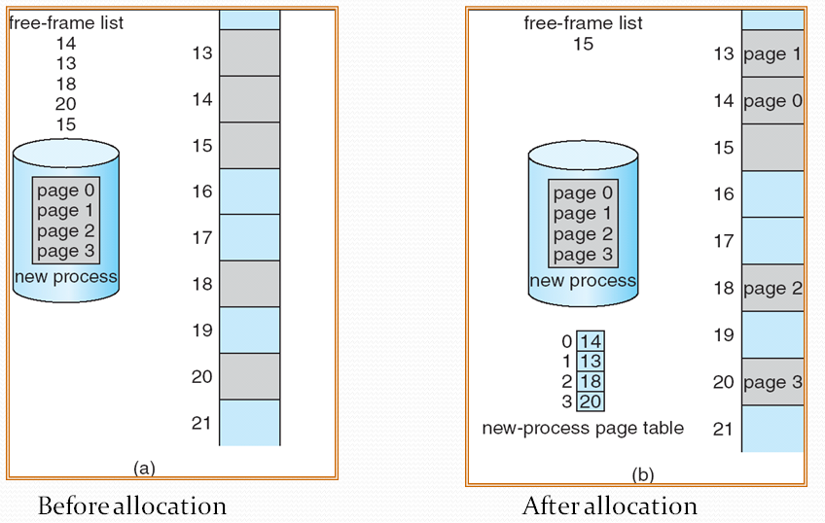
Frame Allocation

Slide 25
Hardware Support: for Page Table Implementation
  Hardware implementation of page table: Methods:
  1. Use Registers
  One option is to use a set of registers for the page table
  The use of registers for the page table is satisfactory if the page table is reasonably small (for example, 256 entries).

Slide 26
Hardware Support: for Page Table Implementation
  2. An alternate option is to:
  Store the page table in main memory, and to use a single register ( called the page-table base register, PTBR ) to record where in memory the page table is located.

Slide 27
Hardware Support: for Page Table Implementation
  Use a very special high-speed memory device called the translation look-aside buffer, TLB.
  Each entry in the TLB consists of two parts:
  a key (or tag) and a value.
  If the item is found, the corresponding value field is returned.
  The benefit of the TLB is that it can search an entire table for a key value in parallel, and if it is found anywhere in the table, then the corresponding lookup value is returned.

Slide 28
Hardware Support: for Page Table Implementation
  TLB is not large enough to hold the entire page table.
  So used as a cache device.
  The percentage of time that the desired information is found in the TLB is termed the hit ratio.
  The percentage of time that the desired information is not found in the TLB is termed the miss ratio.

Slide 29
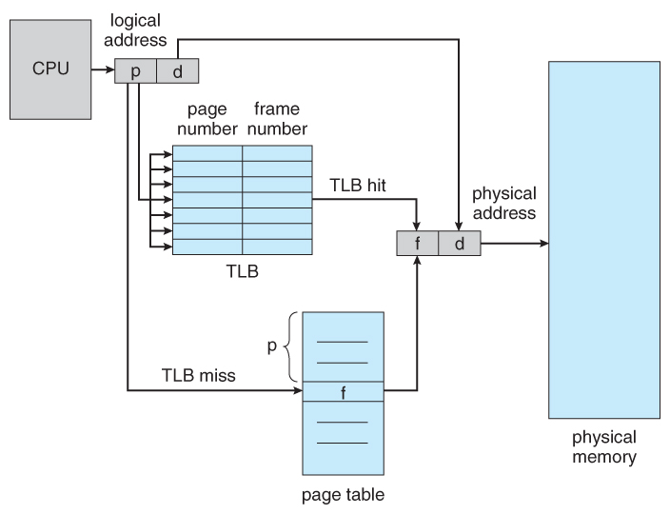
Paging hardware with TLB

Slide 30
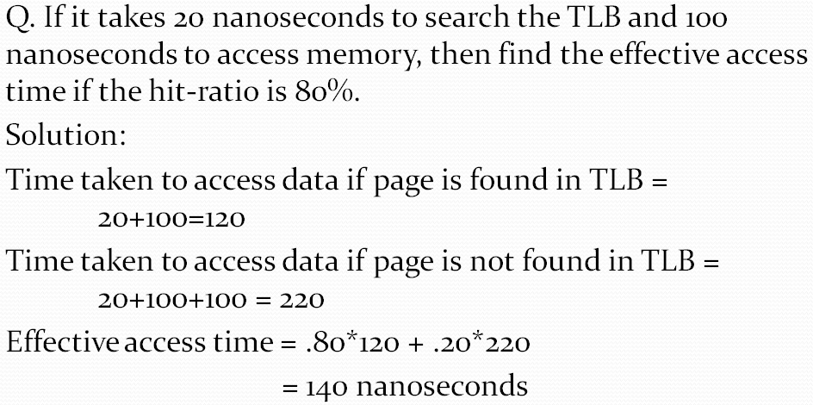
Example
  40% slowdown to get the frame
  Effective access time = hit ratio x time taken for TLB hit + miss ratio x time taken for TLB miss

Slide 31

Example
  Explanation:
  TLB hit takes 120 nanoseconds total ( 20 to find the frame number and then another 100 to go get the data )
  TLB miss takes 220 ( 20 to search the TLB, 100 to go get the frame number, and then another 100 to go get the data.
  Effective access time = hit ratio x time taken for TLB hit + miss ratio x time taken for TLB miss

Slide 32
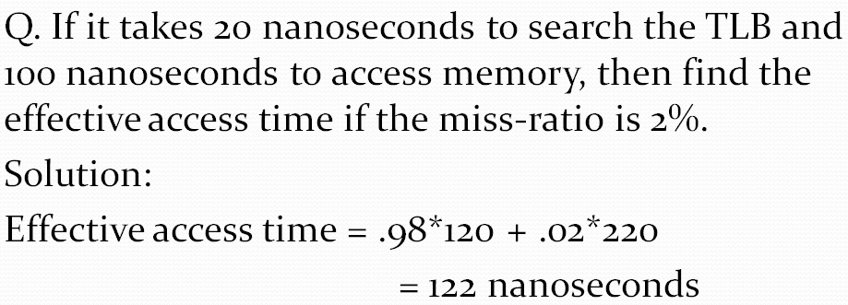
Problem

Slide 33
Segmentation
It is a memory management scheme in which the memory allocated to the process is non contiguous
Logical address space is divided into number of small blocks called segments
Segments are of variable sized.
A C compiler might create separate segments for the following:
1. The code
2. Global variables
3. The heap, from which memory is allocated
4. The stacks used by each thread
5. The standard C library

Slide 34
Segmentation
Users view memory as a collection of variable size segments. With no necessary ordering of these segments
Segmentation is memory-management scheme that supports user view of memory
A program is a collection of segments. A segment is a logical unit such as:
main program, function, object, local variables, global variables, data structures : stack, symbol table, arrays

Slide 35

User’s View of a Program

Slide 36
Segmentation Architecture
Each segment has a name and its length.
Logical address consists of a two tuple:
<segment-number, offset>,
Segment table – maps physical addresses; each table entry has:
  base – contains the starting physical address where the segments reside in memory
  limit – specifies the length of the segment
Segment-table base register (STBR) points to the segment table’s location in memory
Segment-table length register (STLR) indicates number of segments used by a program;
segment number s is legal if s < STLR

Slide 37
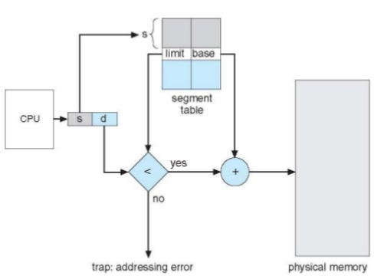
Address Translation: Segmentation Hardware

Slide 38


Slide 39
Problems
Q1.if Segment 2 is 400 bytes long and begins at location 4300, then a reference to byte 53 of segment 2 is mapped onto location?
Ans: base address: 4300
Limit: 400
53<400 (I.e limit)
4300+53=4353.

Slide 40
Problems
Q2. A reference to byte 852 of segment 3 is mapped to?
Ans: 3200+852=4052.
Q3. A reference to byte 1222 of segment 0 is mapped to?
Ans: would result in a trap to OS, as this segment is only 1000 bytes long.

